Slide 1
FINANCIAL ANALYTICS USING PYTHON
Analysis of Market Capitalization and Sales Data
Prachi Yuvraj Khartade

Slide 2
AGENDA
Abstract
Proposed work
Insights and Data Analysis
Conclusion

Slide 3
ABSTRACT
This project involved a detailed analysis of financial metrics, specifically market capitalization and quarterly sales data, for top companies.
The objective was to categorize companies into "large-cap," "mid-cap," and "small-cap” based on their market capitalization and to develop key insights using a variety of data visualization techniques picture in their minds.
Data were clean, transform and analyzed using Python libraries such as panda, numpy, matplotlib, and seaborn. Key concepts includes bar charts , pie charts, scatter plots as well other to analyze and visualize data.
The project provided significant insights into the financial standing of companies, supporting strategic decision-making and enhancing the understanding of market trends.

Slide 4
PROPOSED WORK
Data collection: Collected sales data .
Data cleaning and preparation: Cleaned and transformed the data to ensure it was accurate, complete, and consistent.
Data visualization: Used Python libraries to create charts, tables, and other visualizations that presented the data in a way that was easy to understand.
Analysis and insights: Provided actionable insights into market cap distribution and ratios, aiding strategic decision-making.
Enhanced data visualization skills and deepened understanding of financial data analytics.

Slide 5
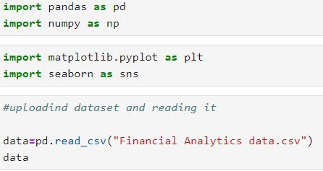
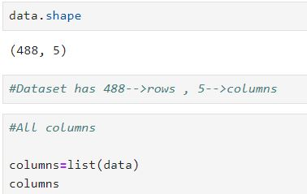







PROPOSED WORK
DATA CLEANING:
Firstly uploaded the dataset and analysed it.
Searched and deal with missing and duplicate values present in them.
Removed unwanted column and used “dropna()” to deal with missing values.

Slide 6
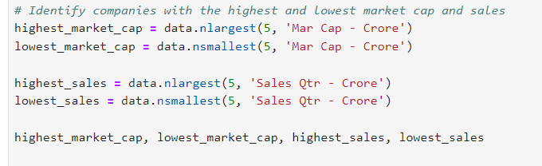
PROPOSED WORK
Exploratory Data Analysis (EDA):
Investigate the distribution of market capitalization and sales.
Analyze the relationship between market capitalization and sales.
Analyze the “outliers” in both the "Mar Cap - Crore" and "Sales Qtr - Crore" columns to see if any of them require special attention or treatment.
It identify the companies with the highest and lowest values to better understand the distribution. Then, I'll proceed with data transformation.

Slide 7
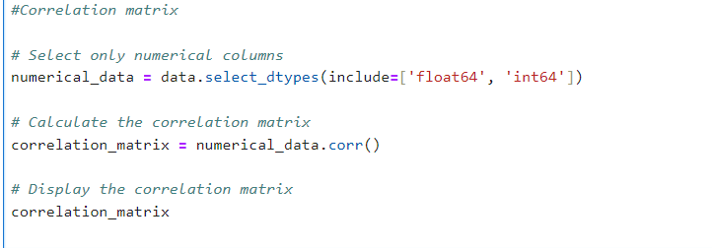
PROPOSED WORK
CORRELATION:
By examining the correlation coefficients, you can identify trends or patterns. For instance, if market capitalization and sales have a high positive correlation, it indicates that companies with higher market caps tend to have higher sales.
The correlation matrix helps to understand the relationships between different numerical variables.

Slide 8
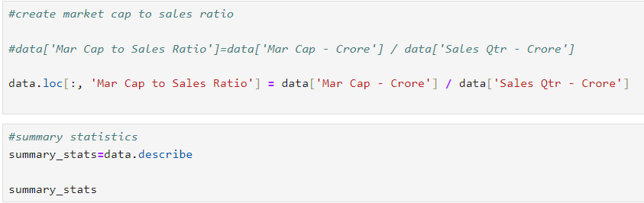
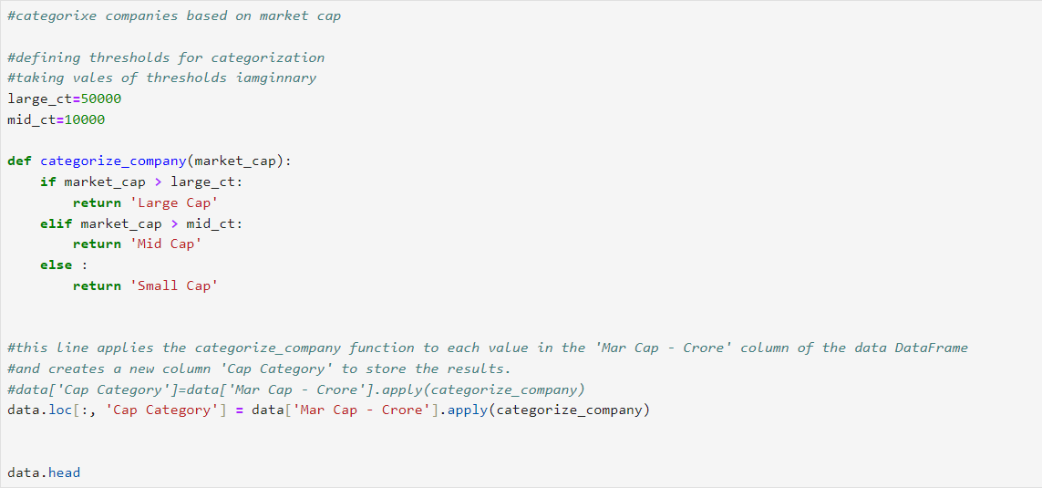
PROPOSED WORK
DATA TRANSFORMATION:
Developed a function to categorize companies based on market capitalization into "Large Cap," "Mid Cap," and "Small Cap."
Created new metrics and calculated the Market Cap to Sales Ratio.

Slide 9
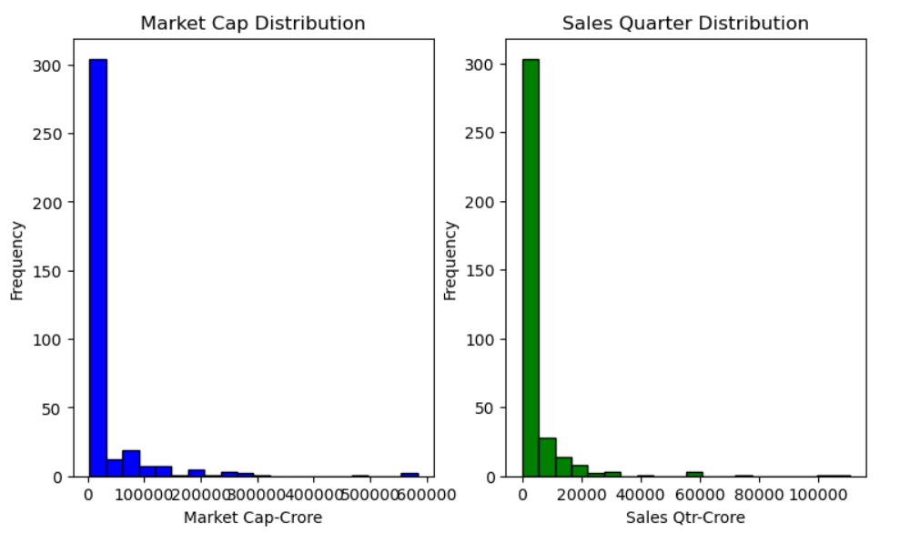
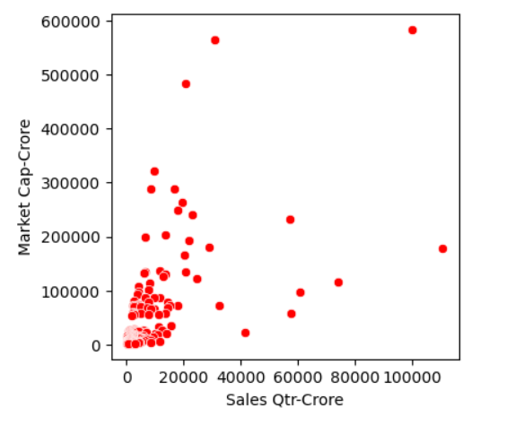
VISUALIZING DATA
Summary Statistics: Get basic statistical information about the numeric columns.
Visualizations: Plot histograms and scatter plots to understand the distribution and relationships between variables.

Slide 10
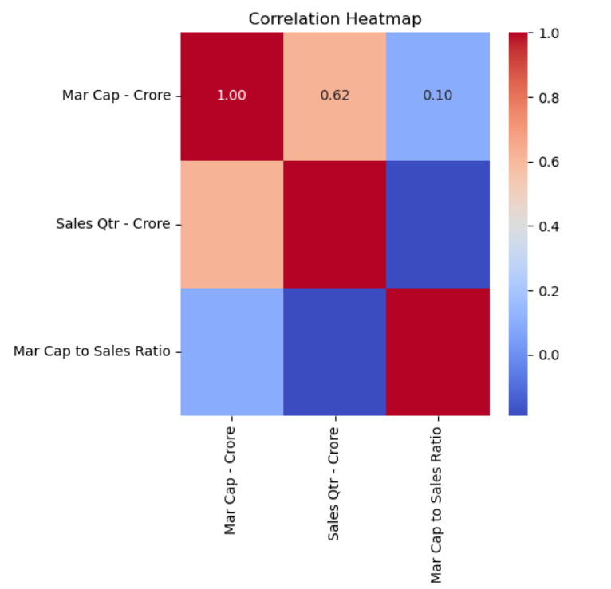
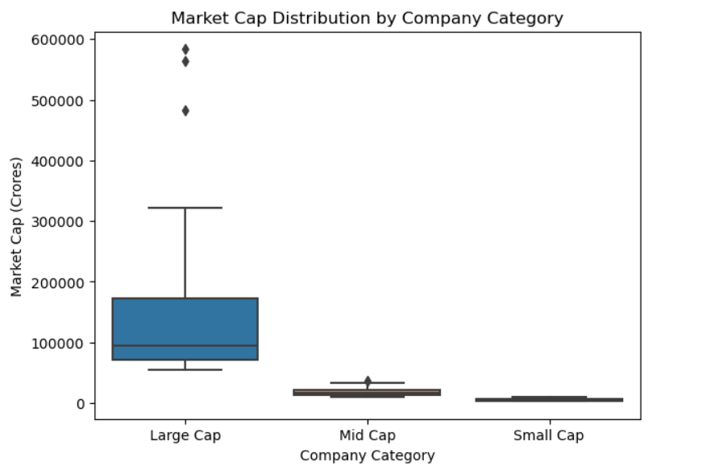
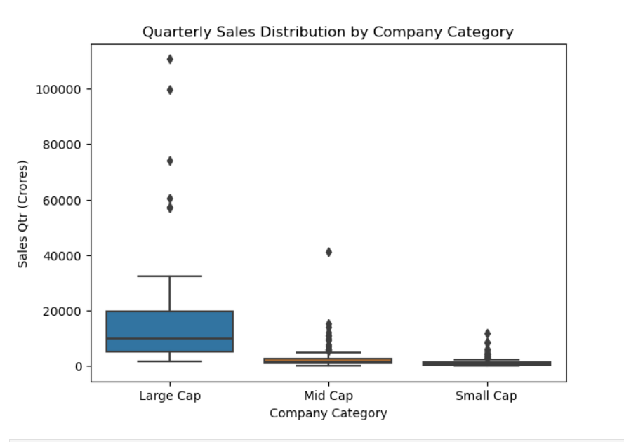
VISUALIZING DATA
Understanding the correlation between different financial metrics can reveal how they are related.
Box plot: Market Cap and sales by Category
A box plot is useful for visualizing the distribution and identifying outliers within categories.

Slide 11
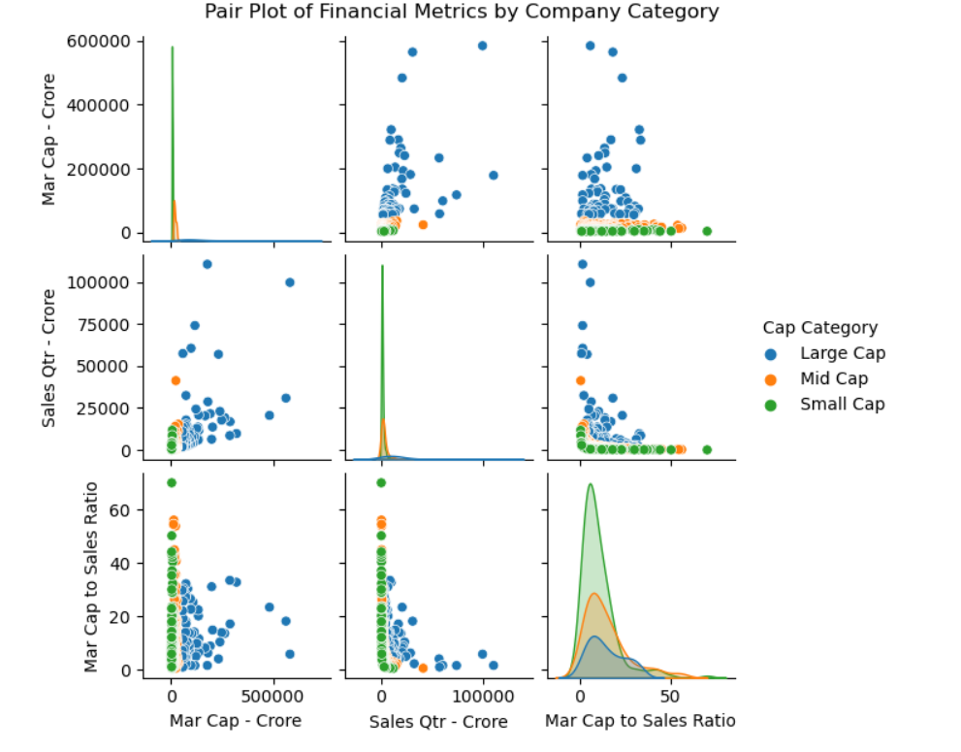
VISUALIZING DATA
A pair plot allows you to see the relationships and distributions for multiple numerical variables in one view.

Slide 12
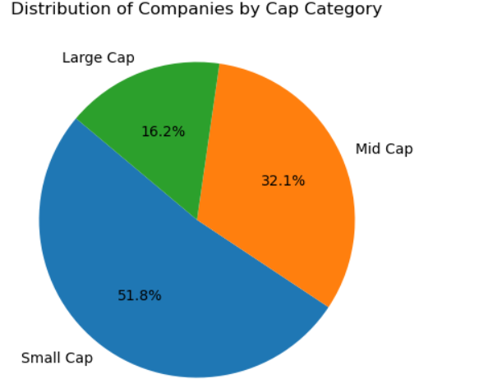
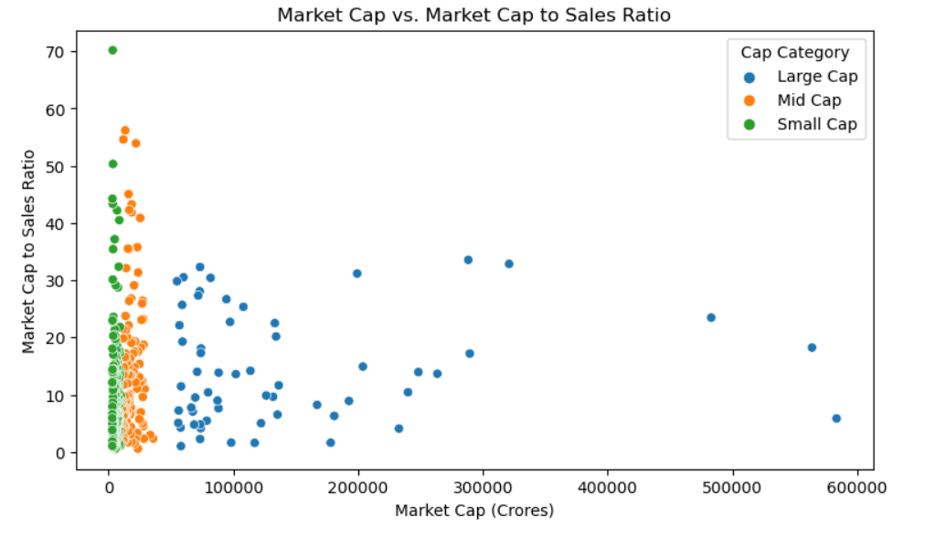
VISUALIZING DATA
Used pie chart to display distribution of companies by cap category.
Visualize how different companies perform based on the Market Cap to Sales Ratio.

Slide 13
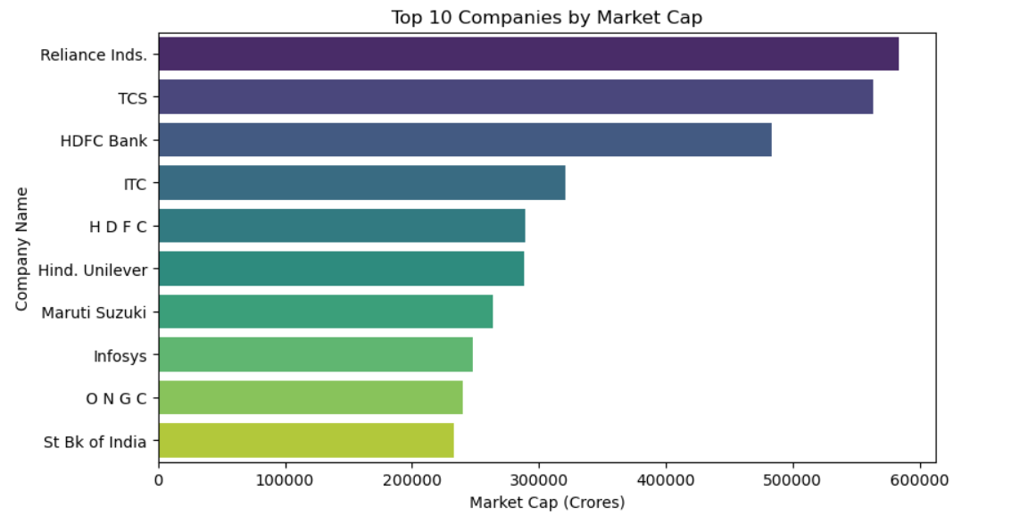
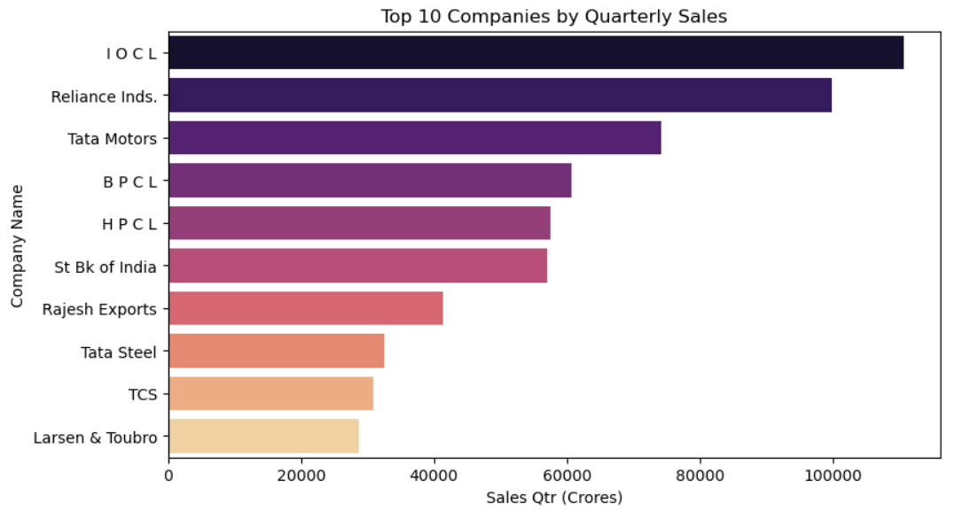
VISUALIZING DATA
Used bar plot to Identify the top 10 companies by market capitalization and visualize them.
Similar to the market cap, you can analyze the top 10 companies by quarterly sales.

Slide 14
INSIGHTS AND DATA ANALYSIS
Outlier Analysis:
Highest Market Cap & Sales:
Companies like Reliance Industries, TCS, and HDFC Bank dominate both market capitalization and quarterly sales, which aligns with their status as large-cap companies.
Lowest Market Cap:
Companies such as Natl.Fertilizer and Orient Cement have the lowest market capitalization, which may classify them as small-cap companies.
Lowest Sales:
Companies like Central Dep. Ser, La Opala RG, and Kaveri Seed Co. have the lowest quarterly sales, indicating they operate on a much smaller scale compared to the giants.

Slide 15
INSIGHTS AND DATA ANALYSIS
Market Cap Distribution:
The histogram shows that most companies have a relatively low market capitalization, with a few outliers having extremely high market caps. The majority of companies in the dataset are small to mid-sized, with only a few large-cap companies.
Sales Quarter Distribution:
Similar to the market cap, the sales quarter data is also right-skewed. Most companies report lower sales figures, with a small number of companies having very high sales. This suggests that the dataset includes a mix of companies with varying sizes, but the majority are likely smaller companies with lower sales.
Scatter Plot: Market Cap vs Sales Quarter:
The scatter plot on the right shows a positive relationship between sales and market capitalization. Companies with higher sales tend to have a higher market cap, although the relationship is not perfectly linear.
The data points are more concentrated in the lower range of sales and market cap, with fewer companies in the higher ranges. However, a few companies with exceptionally high sales and market cap stand out as outliers.

Slide 16
INSIGHTS AND DATA ANALYSIS
Market Cap - Crore vs. Sales Qtr - Crore (0.62):
There is a moderate positive correlation (0.62). This suggests that as a company's quarterly sales increase, its market capitalization tends to increase as well.
Market Cap - Crore vs. Market Cap to Sales Ratio (0.10):
The correlation is weak (0.10).The Market Cap to Sales Ratio likely varies independently of the market cap, suggesting other factors influence this ratio.
Sales Qtr - Crore vs. Market Cap to Sales Ratio (-0.62):
This correlation is negative and relatively moderate (-0.62), meaning that as quarterly sales increase, the Market Cap to Sales Ratio tends to decrease
This could imply that companies with higher sales may have a lower Market Cap to Sales Ratio, possibly because their market cap increases at a slower rate compared to their sales.

Slide 17
INSIGHTS AND DATA ANALYSIS
Large-cap companies dominate in both market cap and quarterly sales, as expected.
Large Cap companies are generally more stable and have higher market capitalizations and sales figures, reflecting their established market presence.
Mid Cap and Small Cap companies exhibit more variability in their financial metrics, which could indicate higher growth potential but also higher risk.
Large Cap Companies represent the largest portion of the chart at 51.8%.
Mid Cap Companies make up 32.1% of the chart.
Small Cap Companies account for 16.2% of the chart.
The market is predominantly composed of Large Cap companies, which could imply stability and established market presence.

Slide 18
INSIGHTS AND DATA ANALYSIS
Large Cap companies are generally more stable and efficiently priced in terms of their sales, reflecting their established market presence.
Mid Cap and Small Cap companies show more variability in their financial metrics, which could indicate higher growth potential but also higher risk.
The dominance of Reliance Industries suggests its significant influence on the market in terms of market cap.
The presence of multiple financial institutions (HDFC Bank, HDFC, SBI) highlights the critical role of the financial sector in the economy in terms of market cap.
IOCL dominates other companies in terms of quarterly sales.
Reliance Industries comes after IOCL which proves its importance and performance in the market.

Slide 19
CONCLUSION
The comprehensive analysis of market capitalization distribution and sales ratios has yielded critical insights that can inform strategic decision-making.
By identifying trends across different market cap categories and visualizing the relationships between market cap and sales ratios, we have enhanced our understanding of market dynamics.
This process also contributed to the development of advanced data analysis and visualization skills using Python, further equipping us for future analytical challenges.

Slide 20
THANK YOU
By Prachi Khartade

